Slide 1

Data Modeling, 9:15, Final Project
Presenter Name: Group 3
Date: 11/29/2022

Slide 2

Team Members
Seungwon Chun
David Rabinovich
Cristian Molina
Rishi Shandal
Amarjit Singh
Rabina Aryal

Slide 3
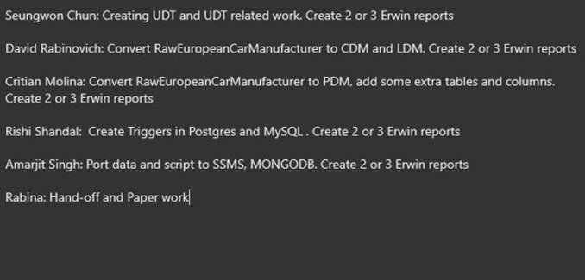
Our Assignment

Slide 4
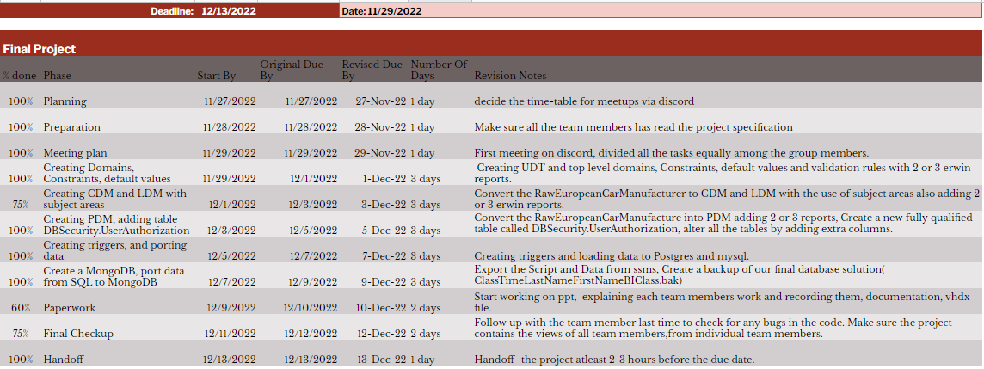
To Do List

Slide 5
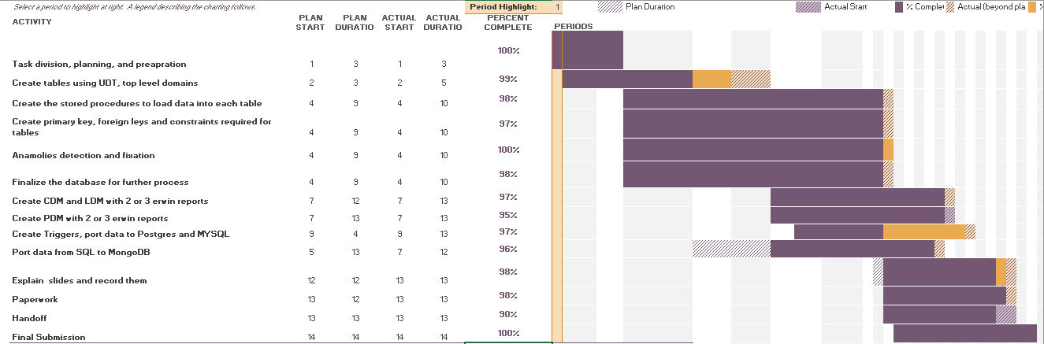
Project Planner

Slide 6
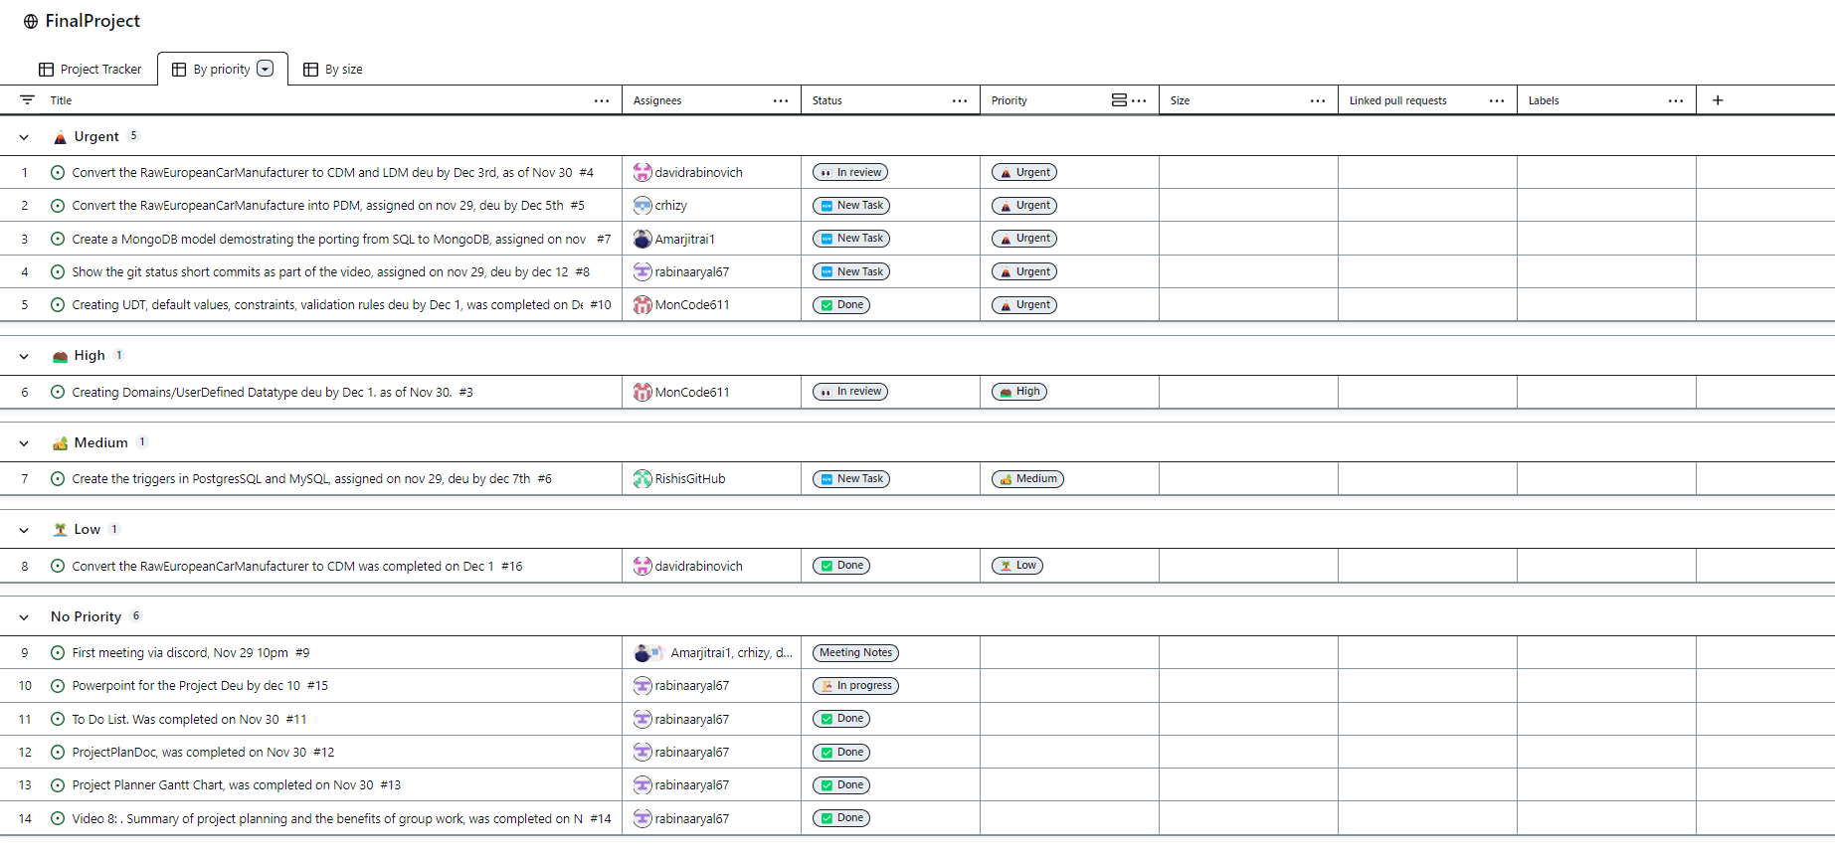
Project Tracking using GitHub
https://github.com/users/rabinaaryal67/projects/8/views/1

Slide 7
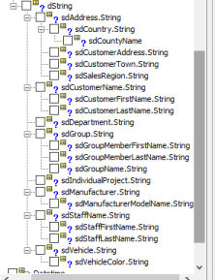
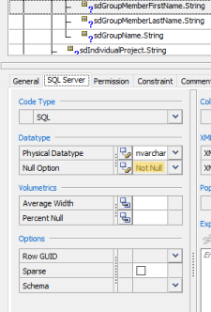
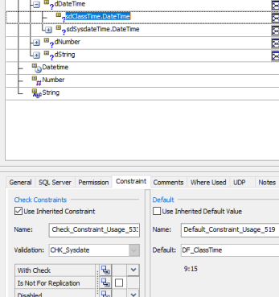
UDT, Constraints, Validation, Default Values Part 1

Slide 8
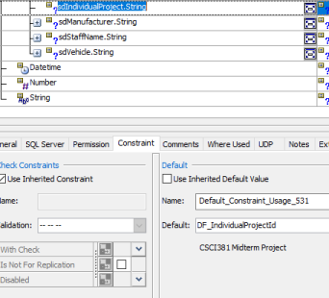
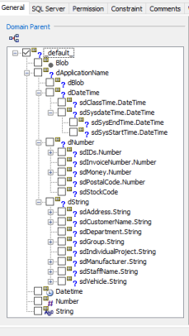
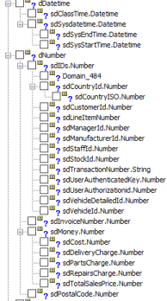
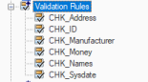
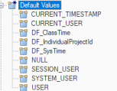
UDT, Constraints, Validation, Default Values Part 2

Slide 9
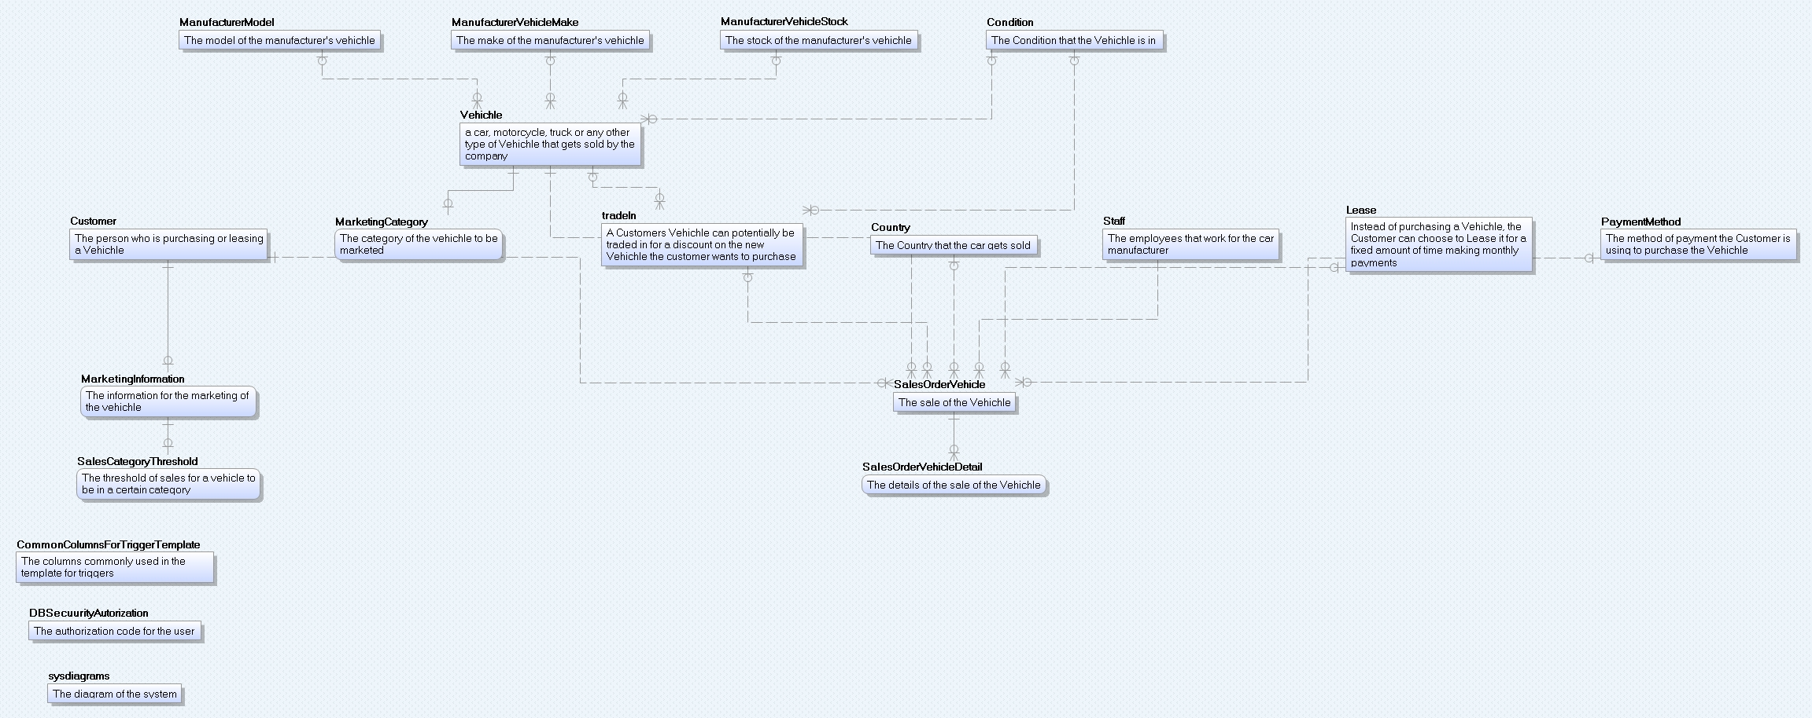
Conceptual Data Model

Slide 10
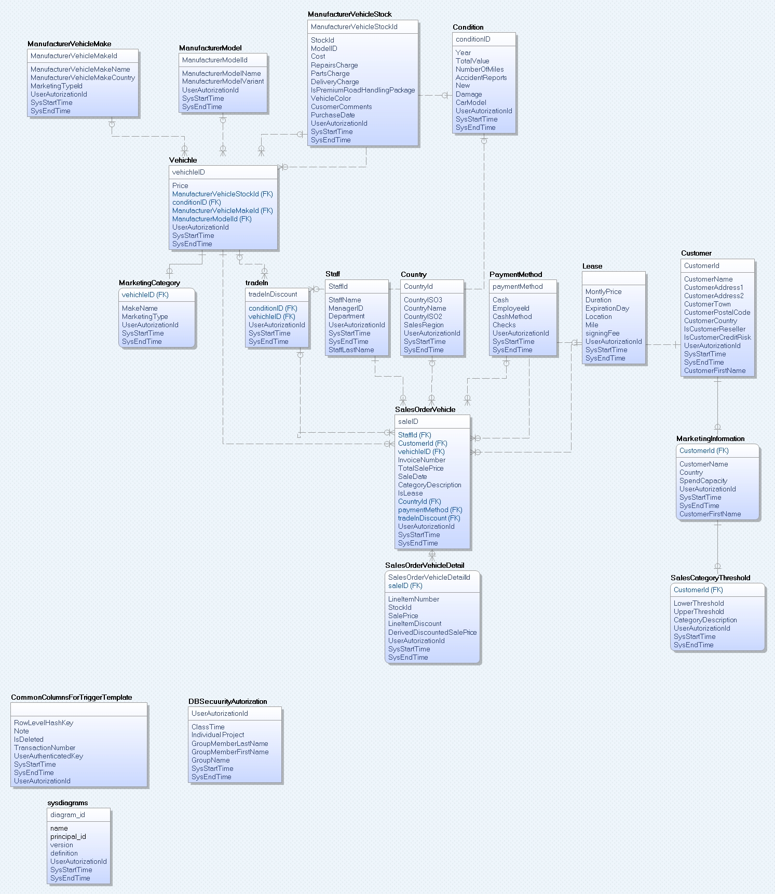
Logical Data Model

Slide 11
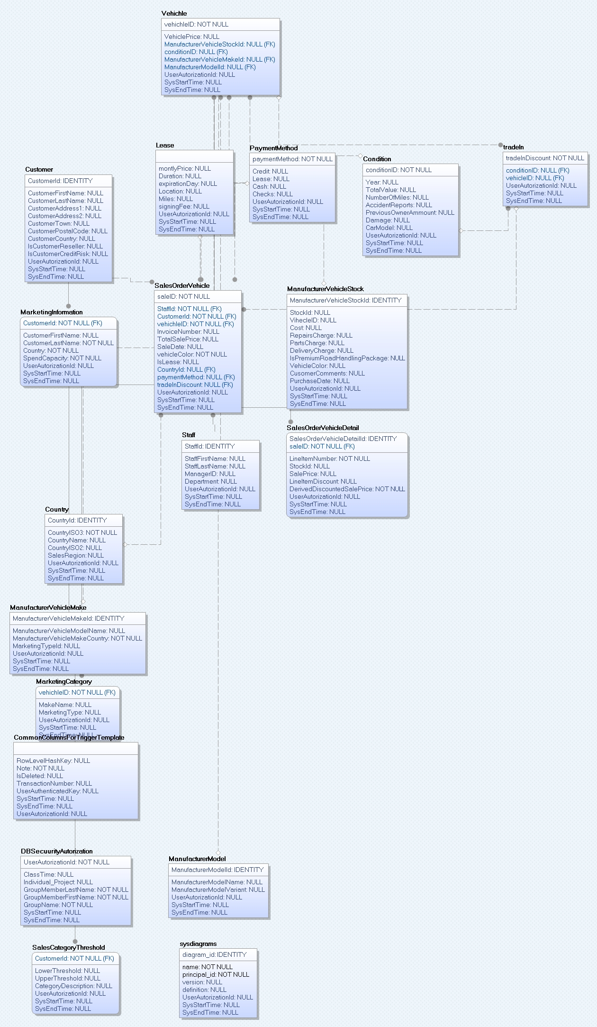
Physical Data Model

Slide 12
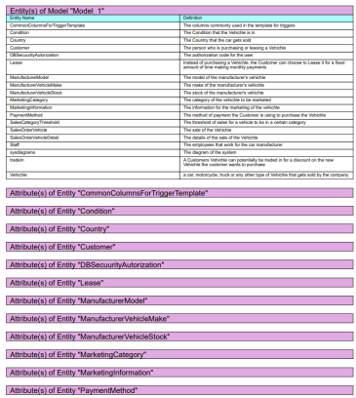
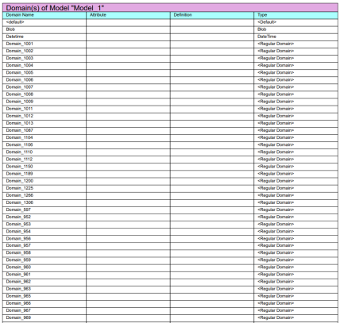
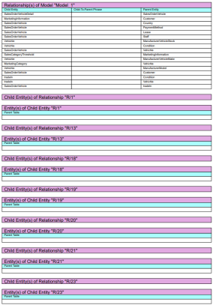
Erwin Reports

Slide 13
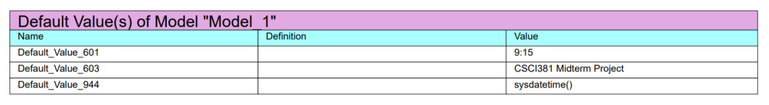
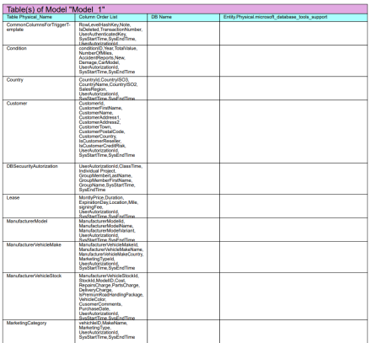
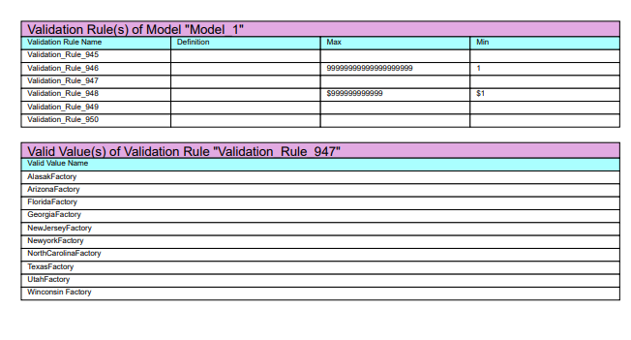
Erwin Reports

Slide 14
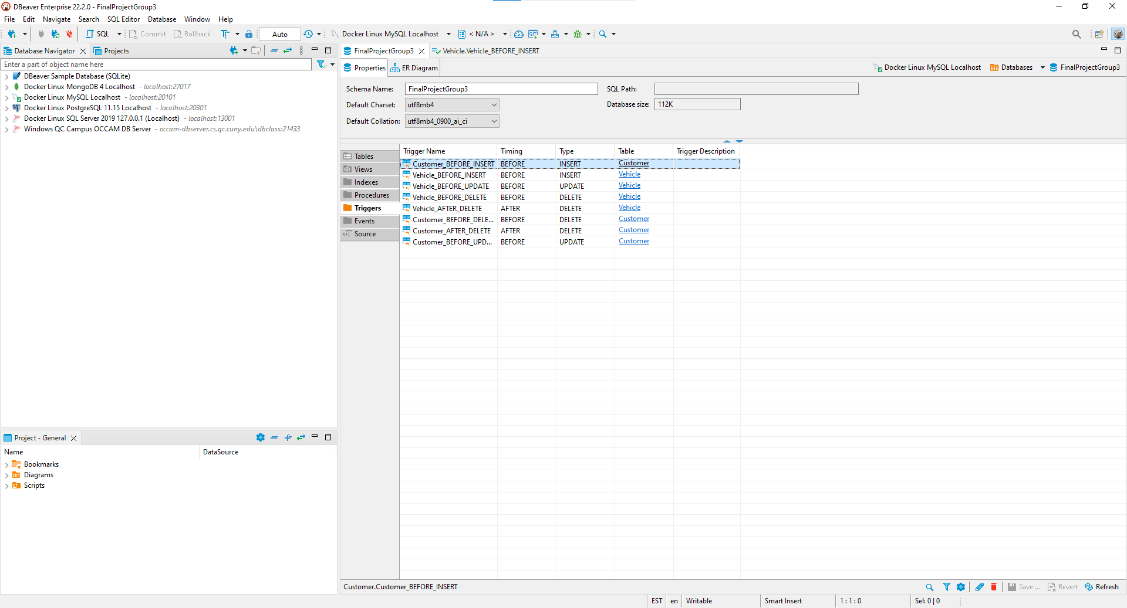
Triggers

Slide 15

Benefits of the teamwork
Pooling of Ideas, expertise and resources.
Shared workload not stressful as working alone.
Time Saving
A team by its very nature encourages communication.
Develop clear performance goals and metrics.

Slide 16

Thank You

